Slide 1
Decadal SST Variability in the East Asian Marginal Seas over Recent Decades: Warming, Hiatus, and Reacceleration
Hyung-Ju Park and Hanna Na

Slide 2
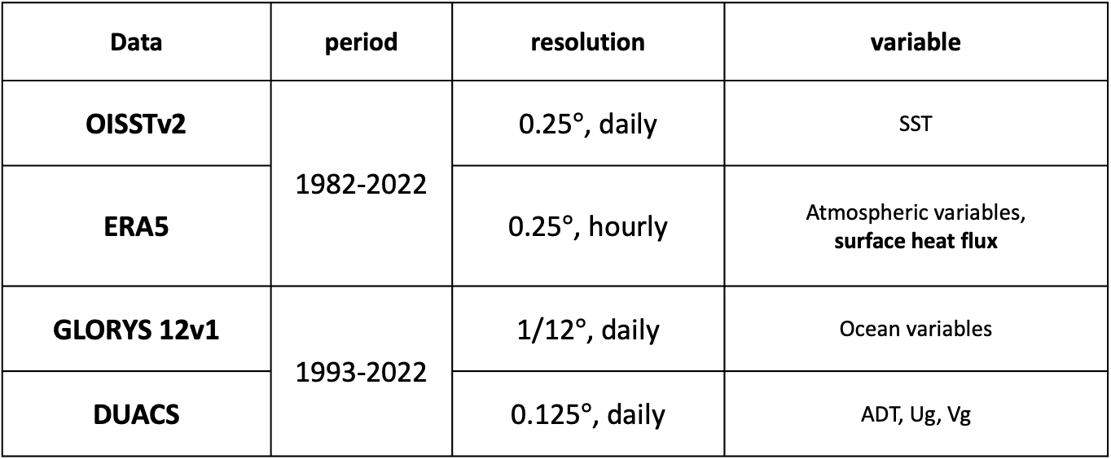
Data and Method
Data | period | resolution | variable
OISSTv2 | 1982-2022 | 0.25$°$, daily | SST
ERA5 |  | 0.25$°$, hourly | Atmospheric variables, surface heat flux
GLORYS 12v1 | 1993-2022 | 1/12$°$, daily | Ocean variables
DUACS |  | 0.125$°$, daily | ADT, Ug, Vg
ERA5 surface heat flux is interpolated to the grid points of GLORYS12v1
Notes:
Now i will introduce the data and methods used in this study.
For sea surface temperature data, Optimum Interpolation Sea Surface Temperature (OISST) version 2 is used
The atmospheric field is based on the ERA5
For precipitation data, Global Precipitation Climatology Project (GPCP) is used
and the ocean data is based on Simple Ocean Data Assimilation (SODA) 3.4.2
The research period was set from 1982, when OISST data became available, to 2022.
The MHW events were defined by applying the method of Hobday et al. (2016) to the OISST data.
For an event to be defined as an MHW,
the temperature must be higher than the 90 percentile for each calendar day.
it should last at least five days
and if the gaps between those events are less than two days , it will be considered as the same event
The baseline period for calculating the anomaly and threshold was set to the entire period, data is available.

Slide 3
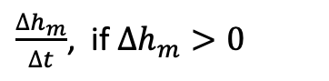
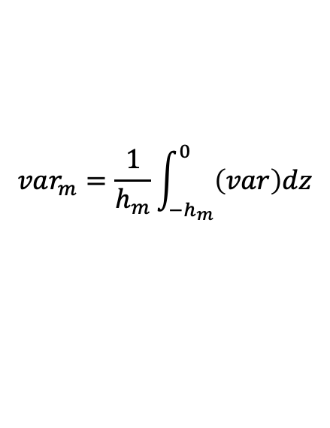
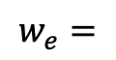
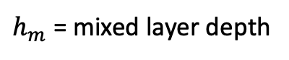
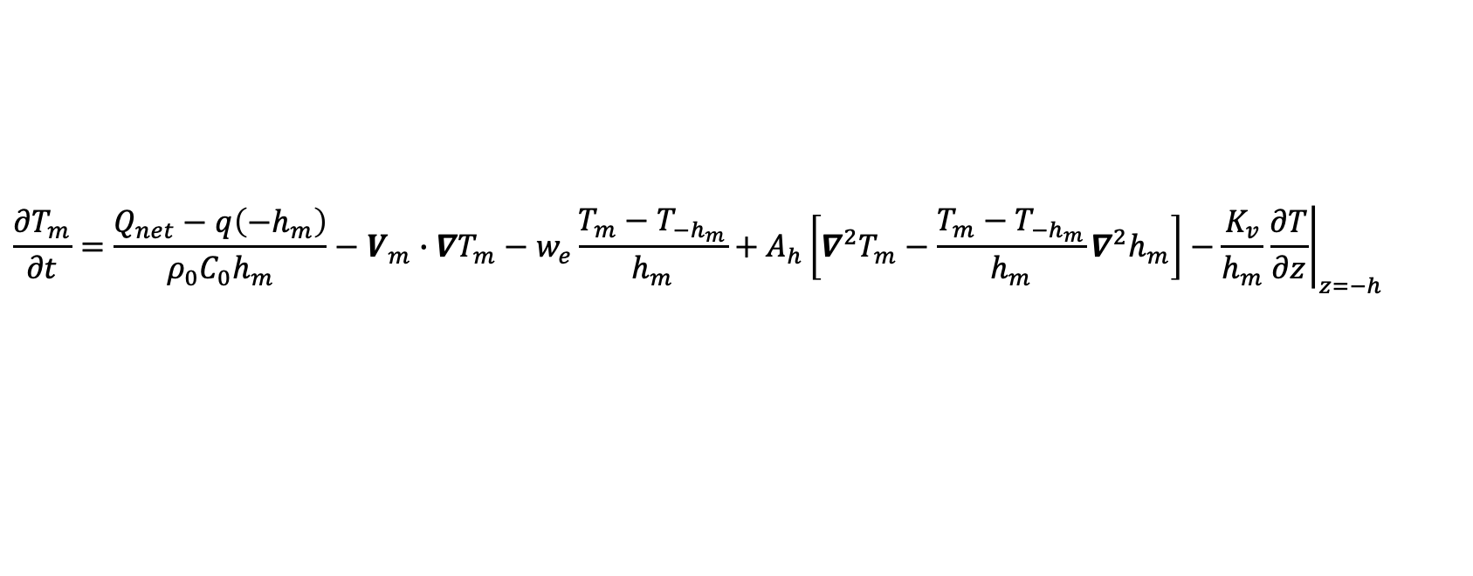
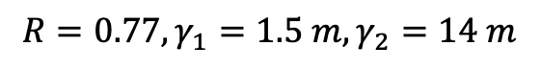
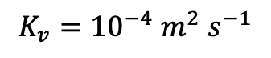
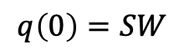
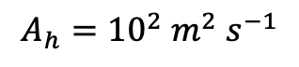
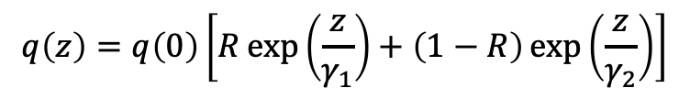
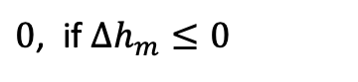
Mixed Layer Heat budget equation
Tendency
Diabatic
Advection
Entrainment
Horizontal diffusion
Vertical Diffusion
$$\frac{∂T_{m}}{∂t}=\frac{Q_{net}−q\left({−h}_{m}\right)}{ρ_{0}C_{0}h_{m}}−V_{m}∙∇T_{m}−w_{e}\frac{T_{m}−T_{−h_{m}}}{h_{m}}+A_{h}\left[∇^{2}T_{m}−\frac{T_{m}−T_{−h_{m}}}{h_{m}}∇^{2}h_{m}\right]−\frac{K_{v}}{h_{m}}{\left.\frac{∂T}{∂z}\right|}_{z=−h}$$
$$var_{m}=\frac{1}{h_{m}}\int_{−h_{m}}^{0}{\left(var\right)dz}$$
$h_{m}$ = mixed layer depth
Qiu and Kelly (1993)
In Diabatic term,
$$q\left(z\right)=q\left(0\right)\left[R\exp\left(\frac{z}{γ_{1}}\right)+\left(1−R\right)\exp\left(\frac{z}{γ_{2}}\right)\right]$$
$$R=0.77, γ_{1}=1.5 m,γ_{2}=14 m$$
Water type II (western Pacific; Jerlov 1968)
$$q\left(0\right)=SW$$
In entrainment term,
$\frac{∆h_{m}}{∆t}$, if $∆h_{m}>0$
$$w_{e}=$$
$0$, if $∆h_{m}≤0$
Eddy diffusivity
$$A_{h}={10}^{2} m^{2} s^{−1}$$
$$K_{v}={10}^{−4} m^{2} s^{−1}$$

Slide 4
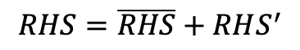
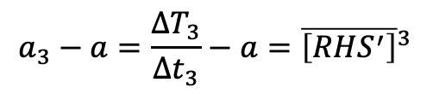
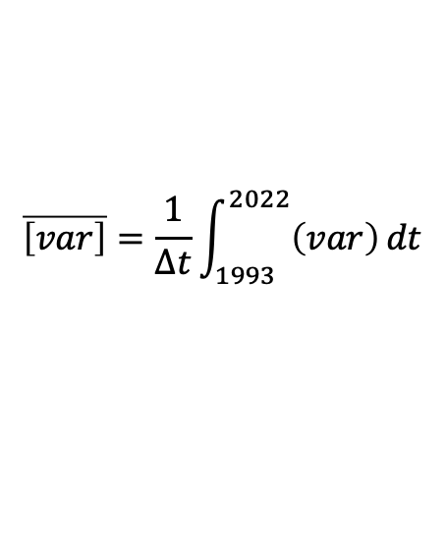
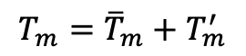
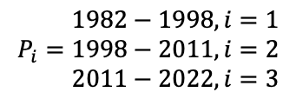
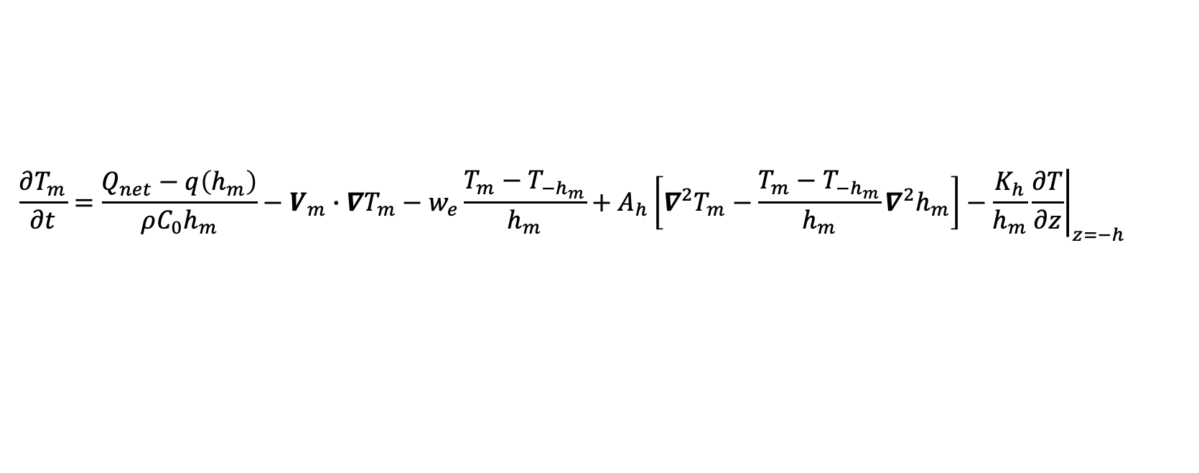
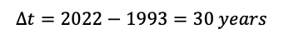
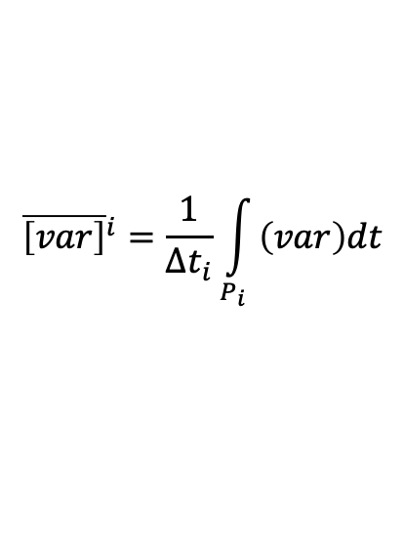
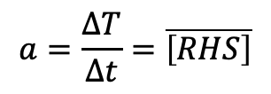
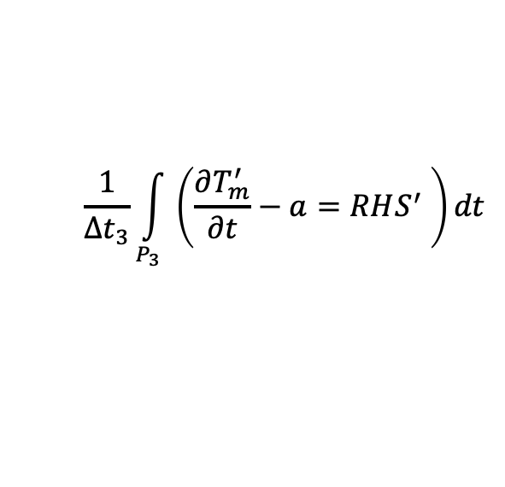
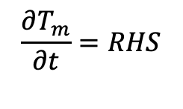
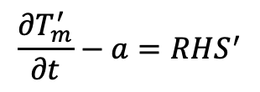
$$\frac{∂T_{m}}{∂t}=\frac{Q_{net}−q\left(h_{m}\right)}{ρC_{0}h_{m}}−V_{m}∙∇T_{m}−w_{e}\frac{T_{m}−T_{−h_{m}}}{h_{m}}+A_{h}\left[∇^{2}T_{m}−\frac{T_{m}−T_{−h_{m}}}{h_{m}}∇^{2}h_{m}\right]−\frac{K_{h}}{h_{m}}{\left.\frac{∂T}{∂z}\right|}_{z=−h}$$
$${\overline{\left[var\right]}}^{i}=\frac{1}{∆t_{i}}\int_{P_{i}}{\left(var\right)dt}$$
$$\overline{\left[var\right]}=\frac{1}{∆t}\int_{1993}^{2022}{\left(var\right)}dt$$
$$P_{i}=\begin{matrix}1982−1998, i=1 \\ 1998−2011, i=2 \\ 2011−2022, i=3\end{matrix}$$
→ Warming
→ Hiatus
→ Reacceleration
$$∆t=2022−1993=30 years$$
$$\frac{∂T_{m}}{∂t}=RHS$$
$$\frac{1}{∆t_{3}}\int_{P_{3}}{\left(\frac{∂T_{m}^{′}}{∂t}−a=RHS^{′} \right)dt}$$
(1)
$$a=\frac{∆T}{∆t}=\overline{\left[RHS\right]}$$
“a” is trend for entire period
$$a_{3}−a=\frac{∆T_{3}}{∆t_{3}}−a={\overline{\left[RHS^{′}\right]}}^{3}$$
(2)
$$T_{m}={\overline{T}}_{m}+T_{m}^{′}$$
As the integration period becomes longer,
The terms in RHS balanced each other, a₃-a becomes smaller
$$RHS=\overline{RHS}+RHS^{′}$$
$$\frac{∂T_{m}^{′}}{∂t}−a=RHS^{′}$$
(1)-(2)
Monthly average is applied

Slide 5
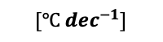
$$[℃ {dec}^{−1}]$$
EJS
ECS
WNP
Overall SST trend (1982–2022): positive, but weaker than in each sub‑period
Warming (1982–1998): significant warming in the East China Sea
Hiatus (1998–2011 ): slight cooling overall; marginal significance only in Yellow & East China Seas
Reacceleration (2011–2022): very strong warming in the northwestern East/Japan Sea, East China Sea, and western North Pacific

Slide 6
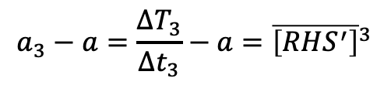
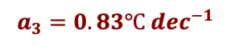
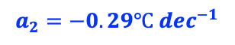
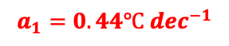
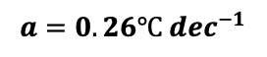
P1: Warming (82–98)
P2: Hiatus (98–11)
P3: Reacceleration (11–22)
$$a_{3}=0.83℃ dec^{−1}$$
$$a_{3}−a=\frac{∆T_{3}}{∆t_{3}}−a={\overline{\left[RHS^{′}\right]}}^{3}$$
$$a_{2}=−0.29℃ dec^{−1}$$
$$a=0.26℃ {dec}^{−1}$$
$$a_{1}=0.44℃ dec^{−1}$$
SST anomaly
Decadal ( > 6 year)
Interannual (2-6 year)
Research on the interannual component was submitted
(Park and Na, Submitted)
The spectral analysis of the SST time series reveals a clear distinction between interannual and decadal components.
Based on the sign of trend, warming, hiatus, and reacceleration periods are separated.
Interannual
Decadal

Slide 7
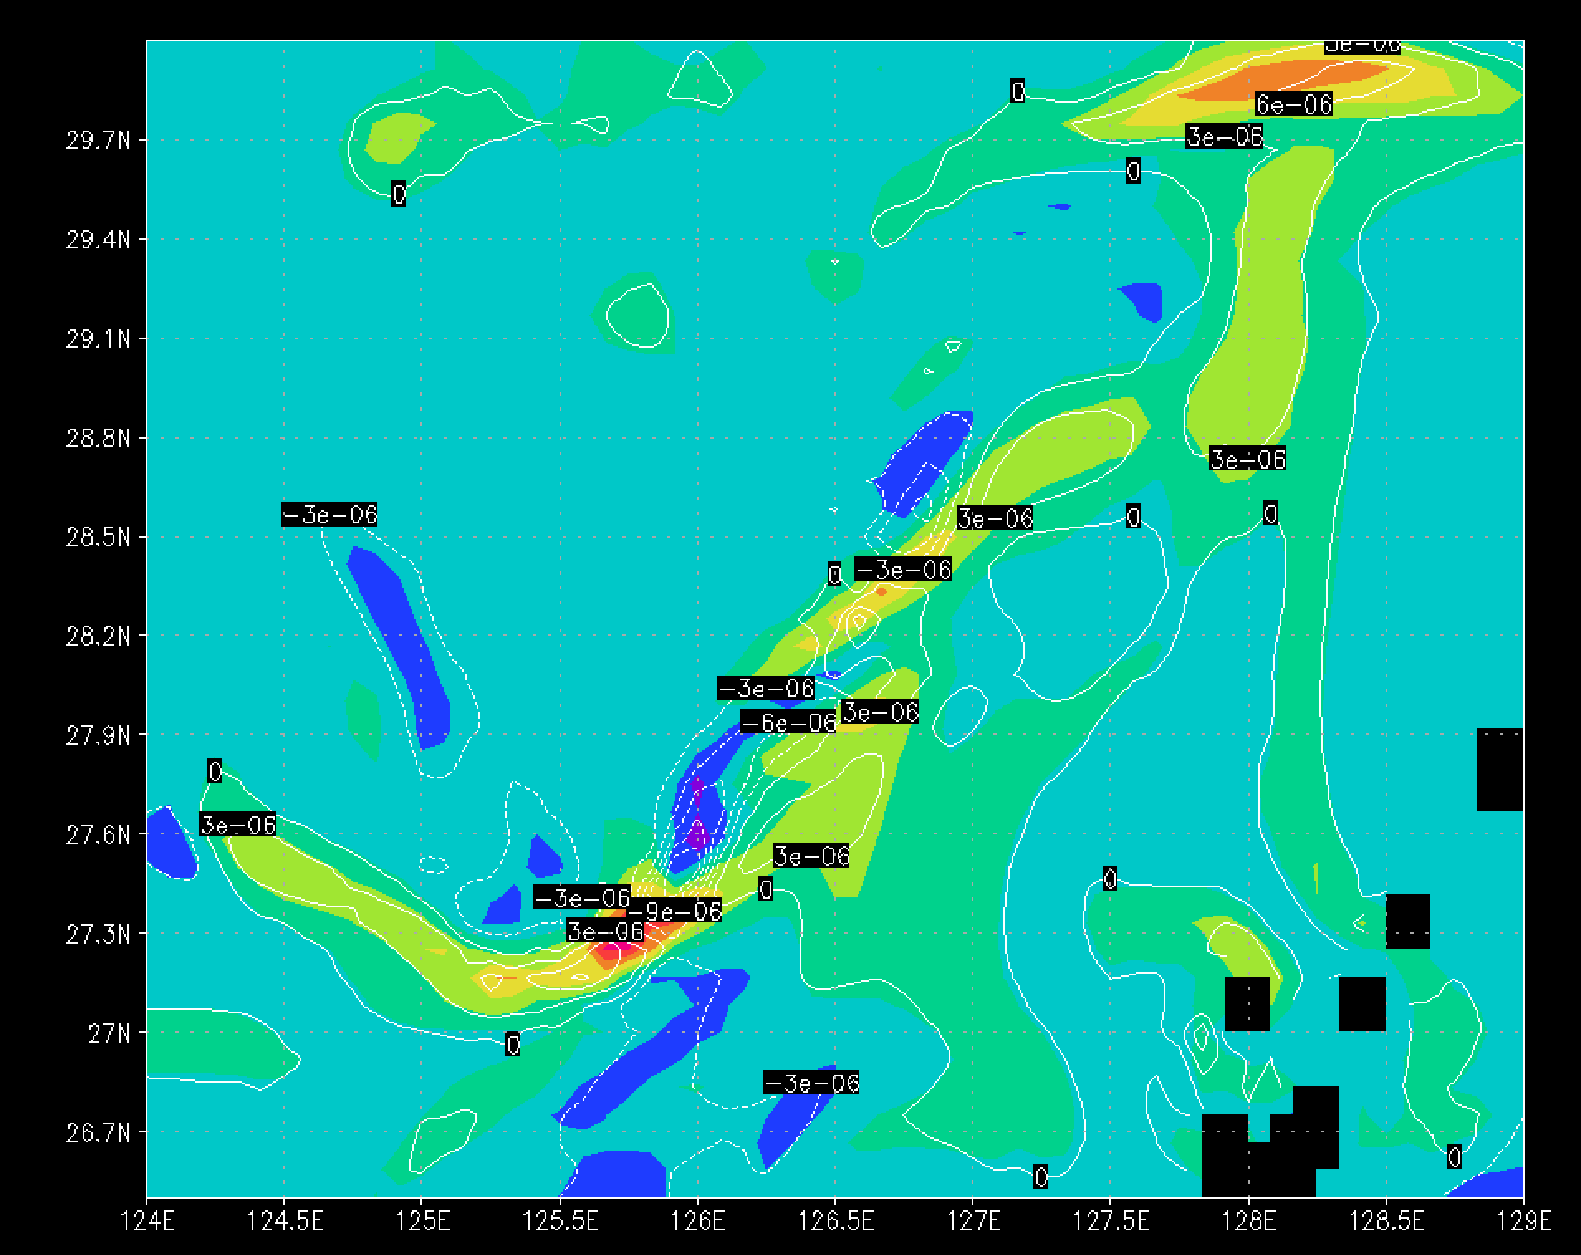
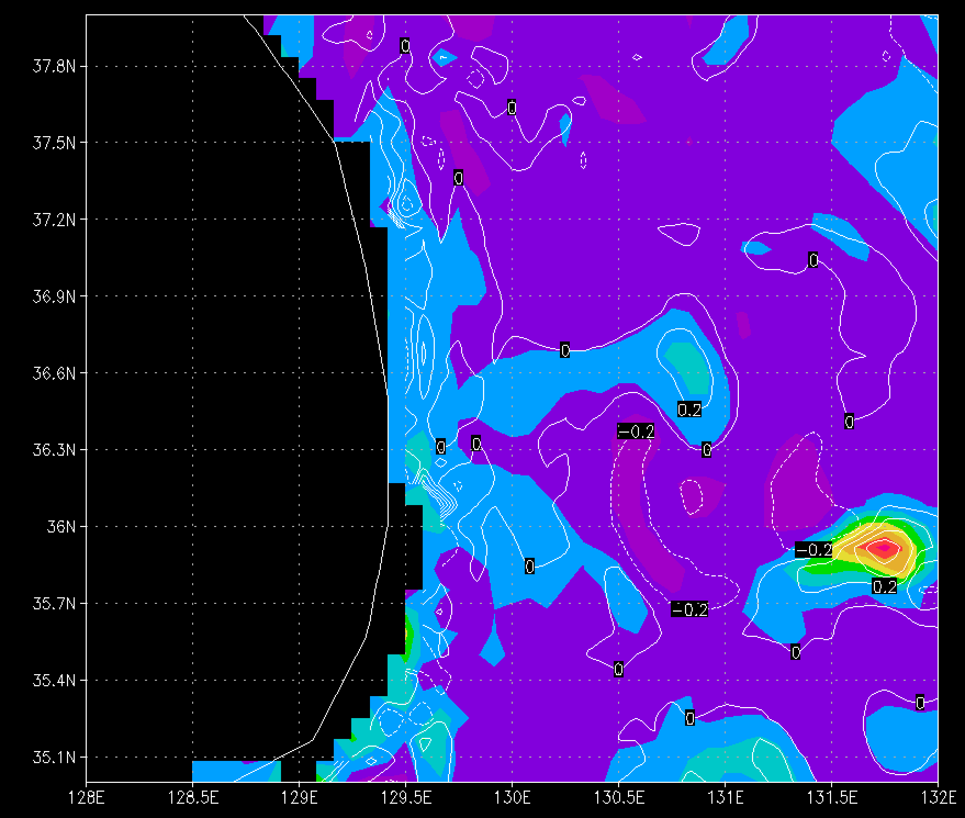
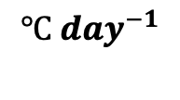
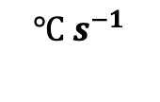
Shading : tendency
Contour : RHS
$$℃ s^{−1}$$
$$℃ {day}^{−1}$$
01 JAN 1993

Slide 8
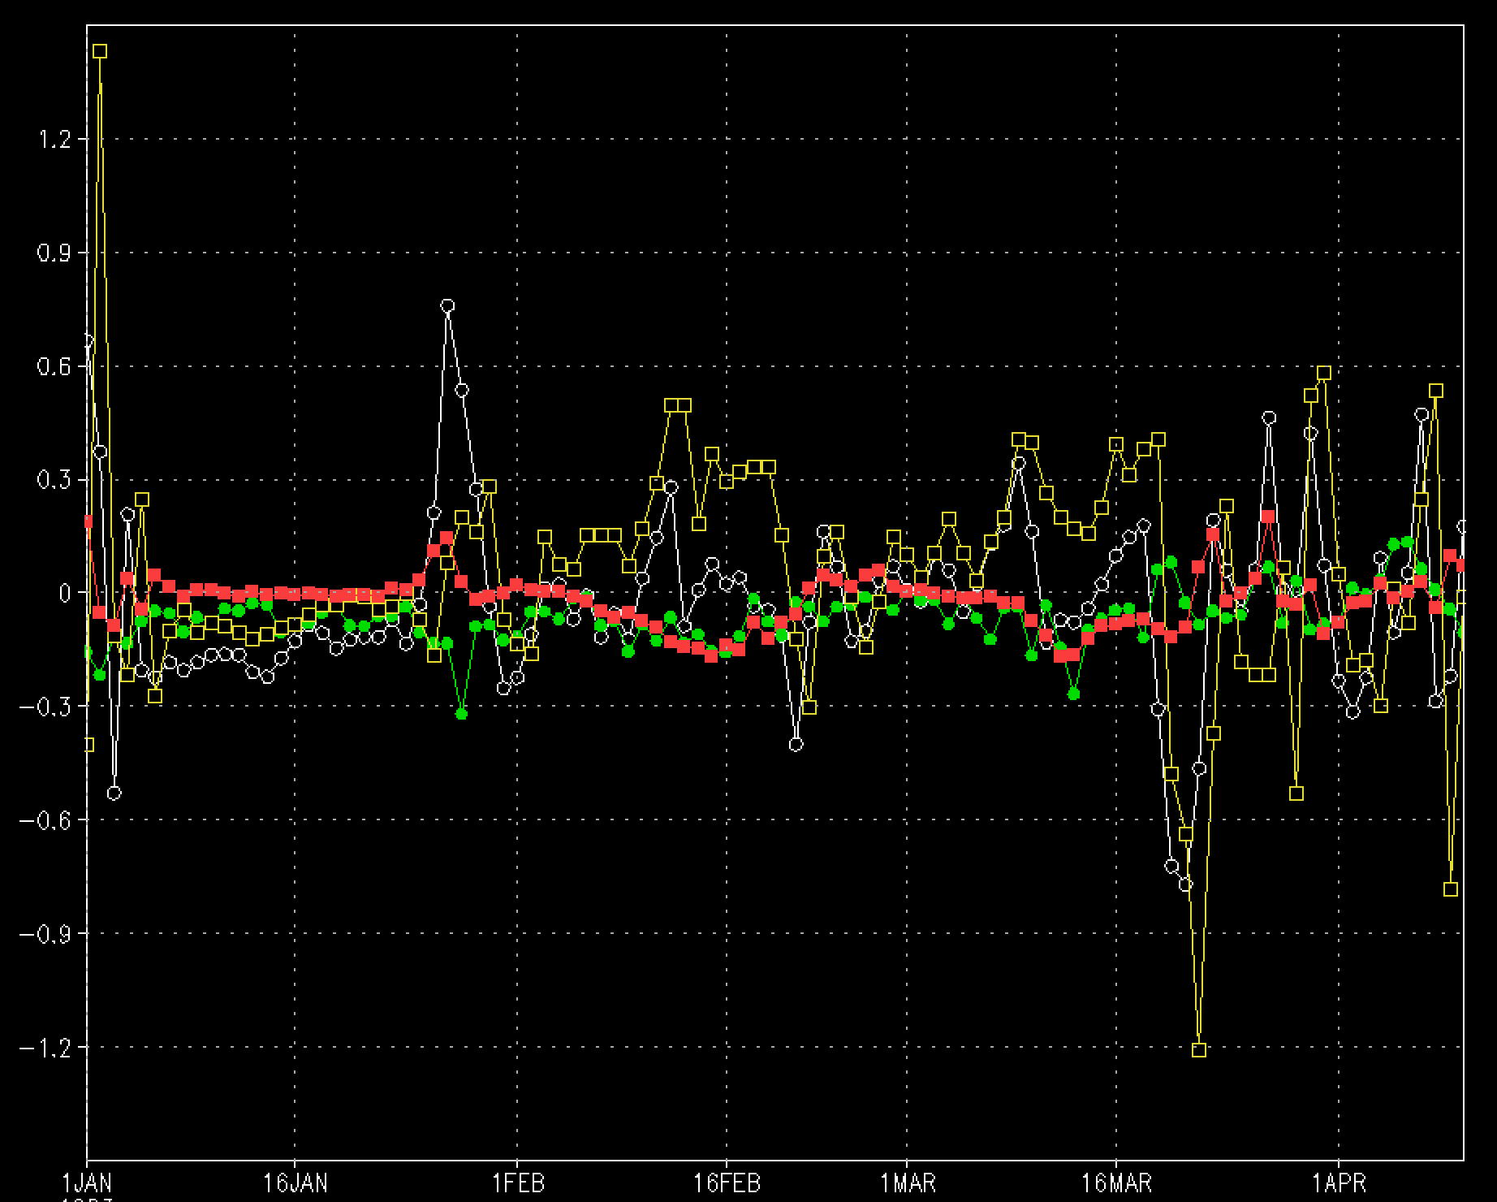
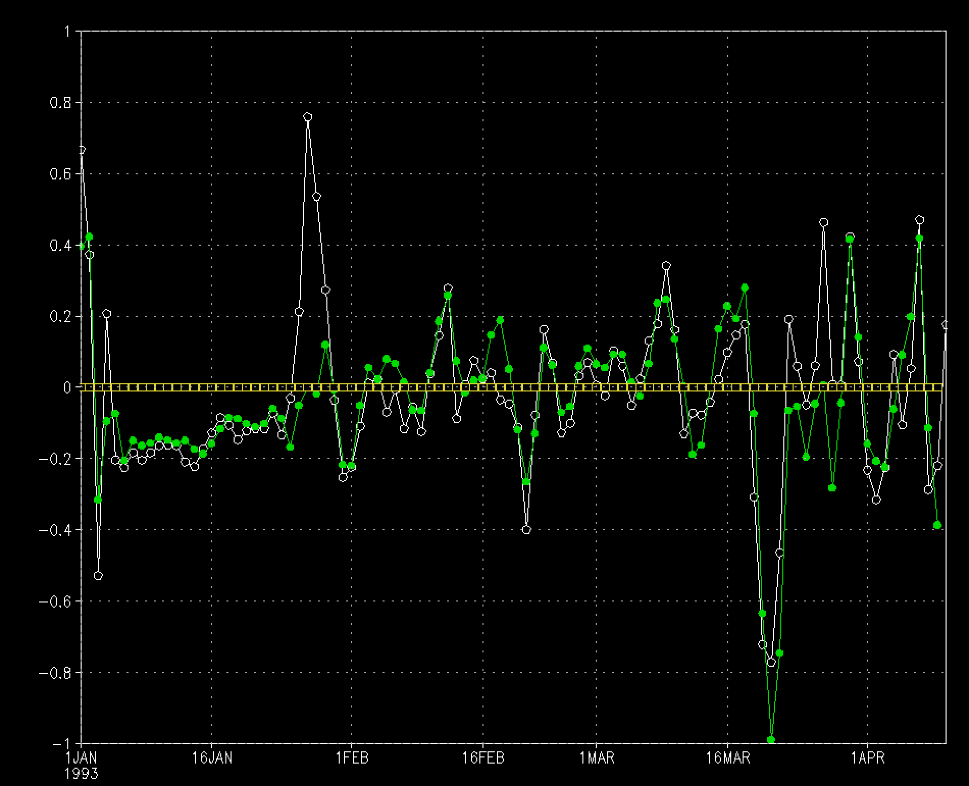
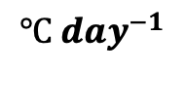
White : tendency
Green: diabatic
Yellow: advection
Red: entrainment + H. & V. diffusion
White : tendency
Green : RHS
$$℃ {day}^{−1}$$
@131E, 36N

Slide 9
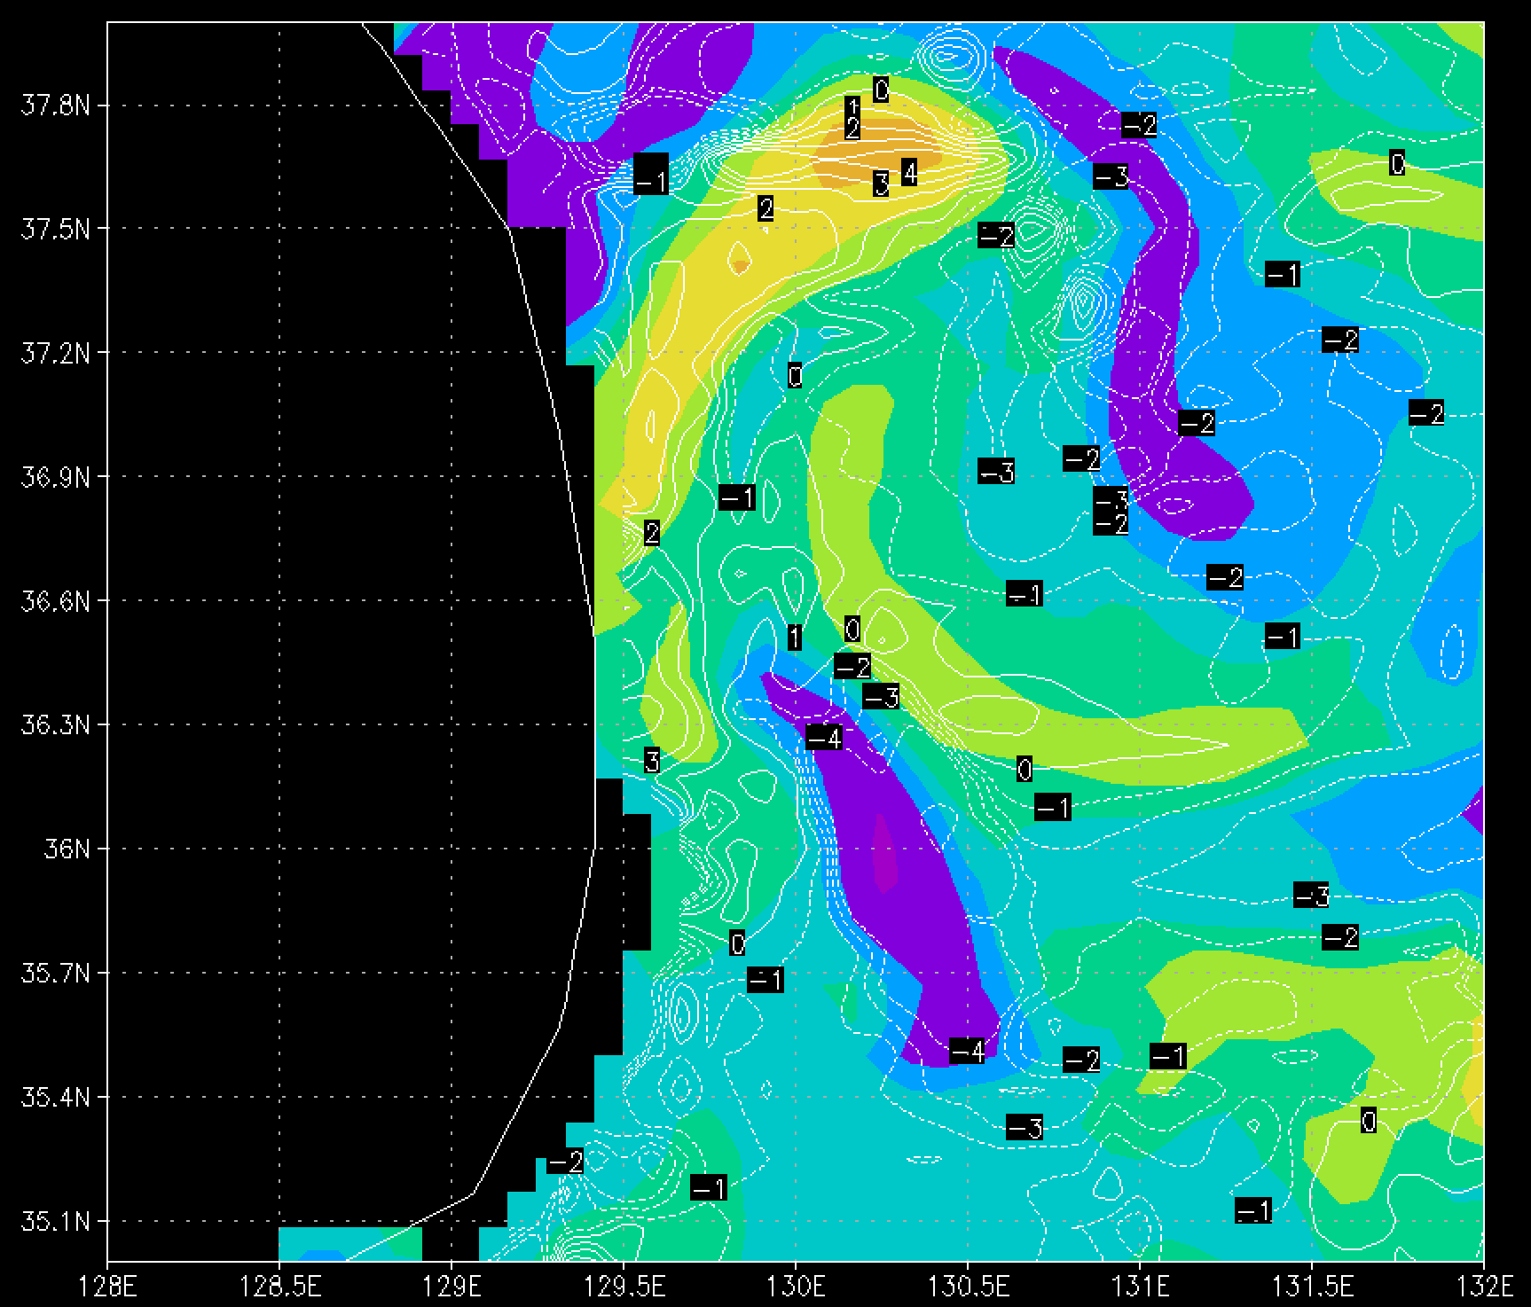
monthly
$$℃ {day}^{−1}$$

Slide 10
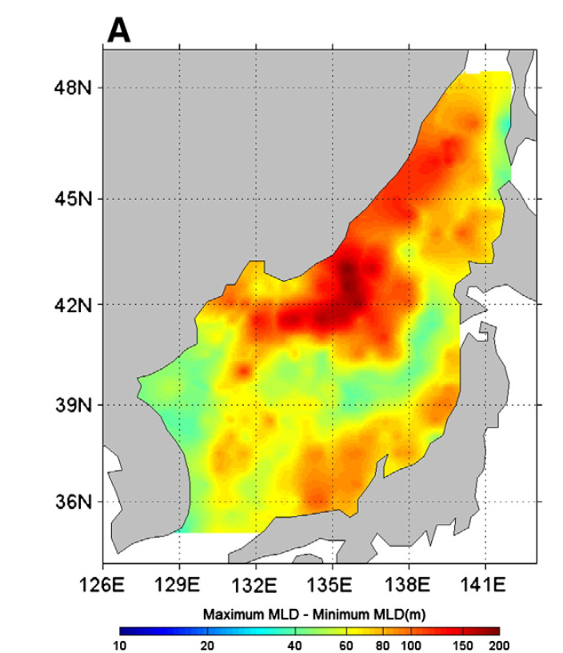
Monthly
Low!!
No seasonal cycle
Numerical scheme?
Resolution?
R²(ten, *)
Dia
Adv
Ent
H. Diff
MLD seas
Lim et al. (2012)
Low
(<10 %)
V. Diff
RHS
High
(>90 %)
Medium
(70~80 %)

Slide 11
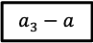
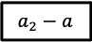
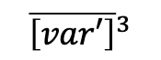
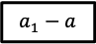
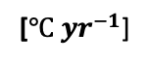
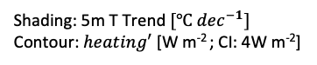
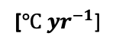
During reacceleration period…
[$℃ {yr}^{−1}$]
$${\overline{\left[var′\right]}}^{3}$$
Dia
Oceanic
a₃ - a
[$℃ {yr}^{−1}$]
Adv
Ent
H. Diff
V. Diff
Not reliable…
P1: Warming (82–98)
P2: Hiatus (98–11)
P3: Reacceleration (11–22)
$$a_{1}−a$$
$$a_{2}−a$$
$$a_{3}−a$$
Shading: 5m T Trend $[℃ {dec}^{−1}]$
Contour: $heating′$ [W m⁻² ; CI: 4W m⁻²]

Slide 12
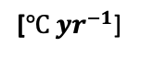
$${\overline{\left[var′\right]}}^{3}$$
Advection
[$℃ {yr}^{−1}$]
U_{m}, V_{m}
ES
YECS
WNP

Slide 13
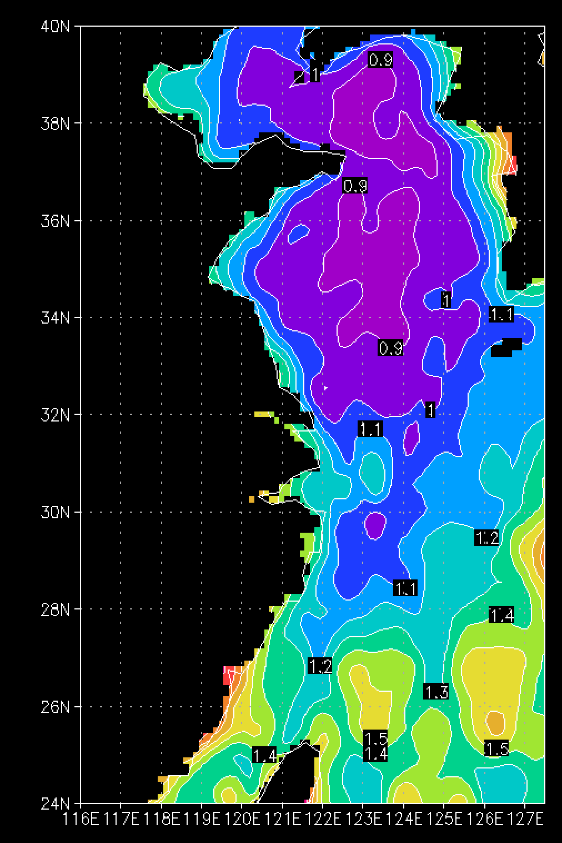
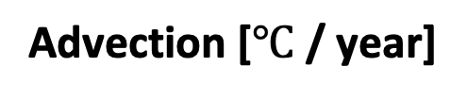
DUACS - ADT [cm]
Advection [$℃$/ year]
$${\overline{\left[var′\right]}}^{3}$$
DUACS SLA Error [cm]
AAC
AC
GLORYS - SSH [cm]
a₃ - a

Slide 14
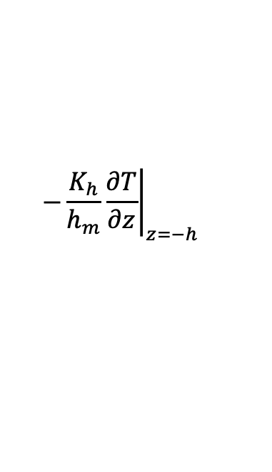
$${\overline{\left[var′\right]}}^{3}$$
$$−\frac{K_{h}}{h_{m}}{\left.\frac{∂T}{∂z}\right|}_{z=−h}$$
V. Diff
MLD [m]
a₃ - a
Weaker vertical diffusion?
Weaker stratification?

Slide 15


DUACS - ADT [cm]
DUACS SLA Error [cm]
Advection [$℃$/ year]
??
AAC
GLORYS - SSH [cm]
a₃ - a

Slide 16


DUACS - ADT [cm]
Physical mechanism for the warm advection?
g’=0.026 m s⁻²
Wind Stress Curl anomaly [x10⁻⁸ N m⁻³]
+ Prop.
Year 0 (2011-2022)
AAC
AAC
-10⁻⁷ N m⁻³ ~ 1.84 cm month⁻¹
WSC
SSH increase
0.4 x -10⁻⁸ N m⁻³ for 4-year
~3.5cm SSH increase
AC
AC
$${\overline{\left[var′\right]}}^{3}$$
Year -1 (2010-2021)
Year -2 (2009-2020)
??
AAC
Year -3 (2008-2019)
Year -4 (2007-2018)

Slide 17



Kang and Na (2022)
The northeasterly wind stress induces onshore Ekman transport, which is associated with the westward shift of the Kuroshio in the ECS
WSC Year-1
DUACS - ADT [cm]
Advection [$℃$/ year]
a3-a
AAC
AC

Slide 18








WNP???
NLM
LM
Reacceleration period!
JAN 2023
SST diff (18-22) – (12-16)
This coastal warming was caused by the approach of the Kuroshio near the coast, which is related to the S-shaped LM explained in Sect. 2 (see Figs. 3 and 4e) and the westward bifurcation of the Kuroshio
Advection
SSH

Slide 19

Discussion
Regressed SST & SLP
P1 (1982−2006; 25-year)
P1
82–06
82-02
89-95
92-99
85-06
PDO
NPGO
IOBM
EAWM
P2
02–22
P2 (2002−2022 ; 21-year)
Correlation with NPGO & PDO reversed in late 2000s (compared to the correlation prior to regime shift)
Both mechanism and drivers are changed during recent decades!
Kim et al. (2018)

